Slide 1
Scuba-Steve
Annotation
The best annotation tool with human in the loop automation.

Slide 2
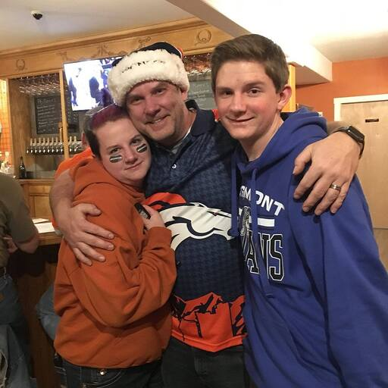

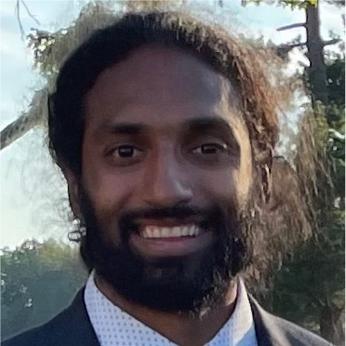
Scuba Steve Team
Chris
Anjan
Art
Chris Labbe
Intro & Overview
Fengyi (Art) Jiang
Tech Stack & UI
Anjan Patnaik
Models & Metrics

Slide 3
Problem Statement

Slide 4
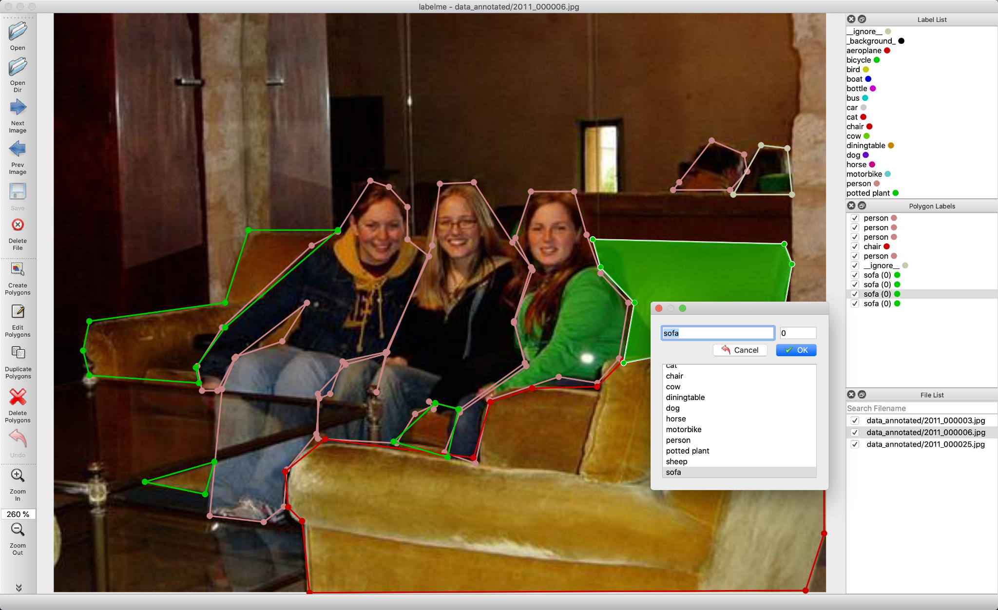
Smart Annotation Platform with Deep Learning
Problem
Computer Vision Training needs lots of annotated images
Annotation requires manual outlining or point selection
Global labelling market ~$1.3B in 2020 w/ est. CAGR of 25.6%
Solution Hypothesis
Use generalized region proposal models to outline objects
Human input to what that object is
Test of Value
Time to generate meaningful annotated images
Mean Average Precision (mAP) vs State of the Art models
LabelMe annotation GUI
Notes:
https://github.com/wkentaro/labelme
Appropriate use of Machine Learning and Computer Vision could automate this process saving hundreds of millions in labor and time cost.
Additionally, a system capable of such work could also be utilized for revenue generation through SAAS to parse images into sub-shapes for use in digital artwork, ad development and education.

Slide 5
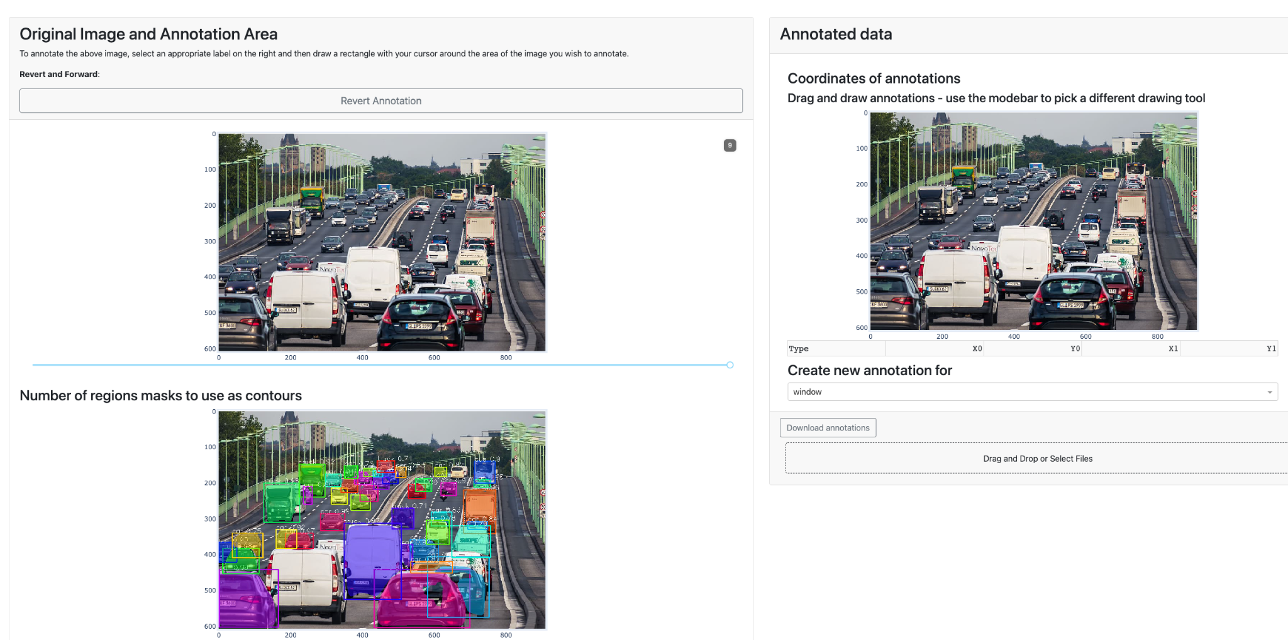
Scuba Steve Is the Future
Manual drawing if needed
Bounding Box object selection
SOTA model performance
Adjust regions in output
(more about this later)

Slide 6
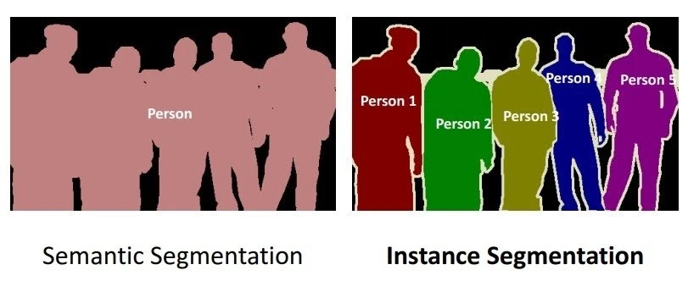
Project Goals
Improve annotation speed
Easy to use, interactive and flexible interface
Reasonable quality contours in lowest time
Train and infer on new classes of objects
Improve inference on existing classes
Semantic segmentation: Classify objects
Instance Segmentation: Identify each object
Notes:
https://viso.ai/deep-learning/mask-r-cnn/

Slide 7
Workflow Overview and Demo

Slide 8



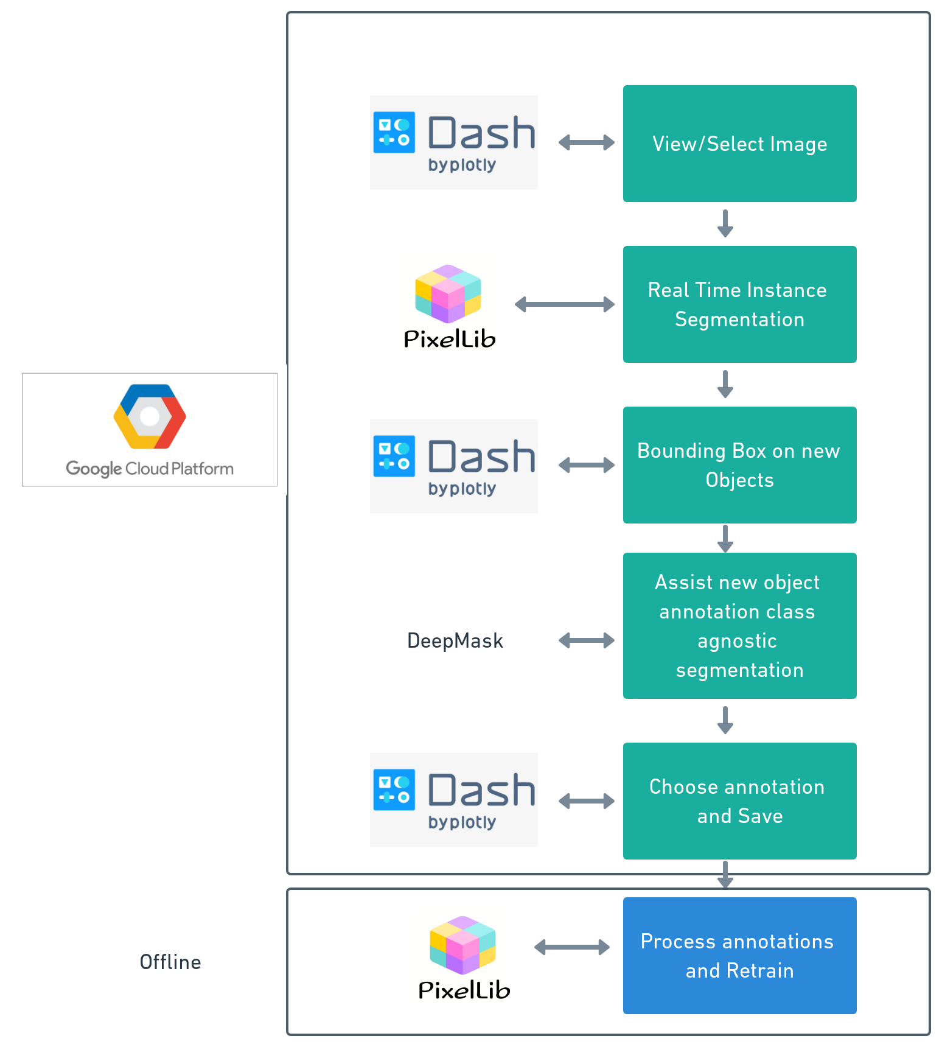

Technical Stack
ML
Instance Segmentation - Pixellib
Class-less Segmentation - DeepMask
Deployments:
Dash Plotly based on Node.js, Flask.
GCP Cloud Operation
Training on AWS & home GPU systems
Publicly available at: https://ML-Label.art

Slide 9
Instance Segmentation On The Go
Automatic Polygon Generation
Custom Training on New Classes

Slide 10
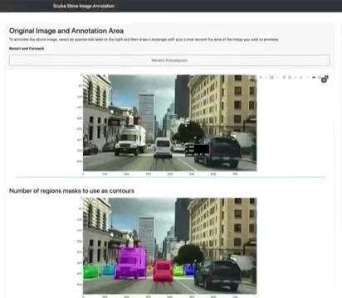

Instance Segmentation On The Go

Slide 11
Technical Stack

Slide 12
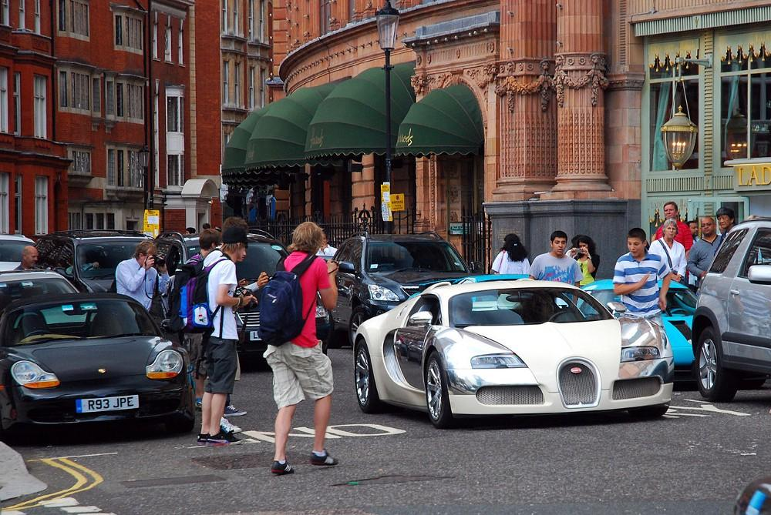
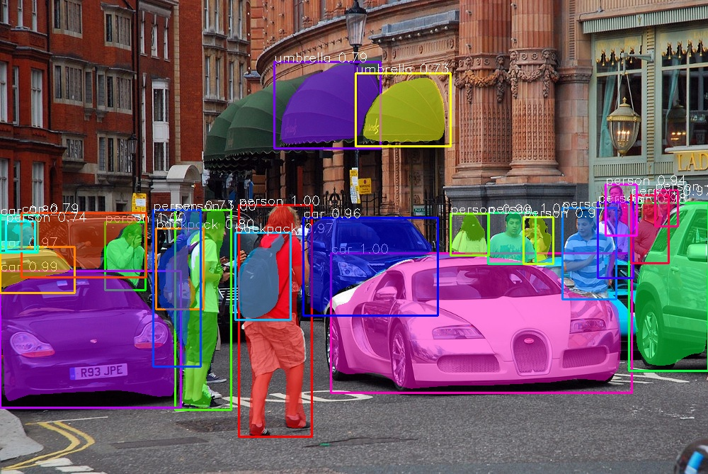
Instance Segmentation with Mask R-CNN
Mask-RCNN: Mask R-CNN, or Mask RCNN is state-of-the-art in terms of instance segmentation (detecting and delineating objects of interest)
The pixellib library has an excellent pre-trained model on the COCO dataset (80 classes).
Adding new classes is still an arduous labeling task.

Slide 13
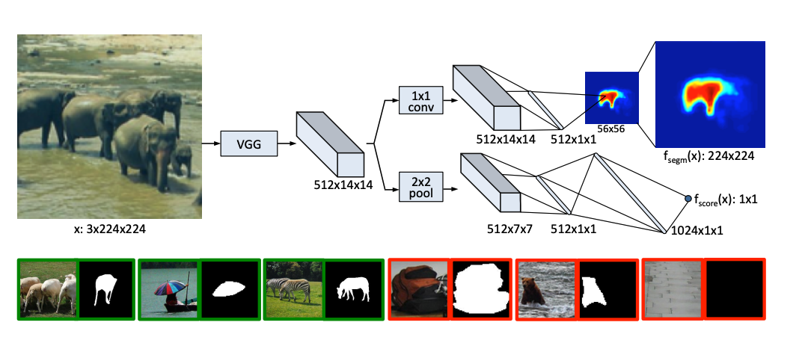
Generalized Object Discovery with Deep Mask
Deep Mask is a generalized object discovery model that does not aim to predict the class of the object.
It has good recall on objects not present in the training set.
Useful model for proposing regions for previously unseen objects specified by a bounding box.
Model architecture: the network is split into two branches after the shared feature extraction layers. The top branch predicts a segmentation mask for the the object located at the center while the bottom branch predicts an object score for the input patch.
Notes:
Learning to Segment Object Candidates - Arxiv. https://arxiv.org/pdf/1506.06204.pdf. (Bottom) Examples of training triplets: input patch x, mask m and label y. Green patches contain objects that satisfy the specified constraints and therefore are assigned the label y = 1. Note that masks for negative examples (shown in red) are not used and are shown for illustrative purposes only.

Slide 14
Retraining Mask R-CNN Base Model
Generate new class labels and polygons for through DeepMask.
Leverage pixellib and PyTorch to train a Mask-R CNN base model to detect this new class.
Train models for 100s of epochs on RTX3080 GPU.
Evaluate performance per epoch and report metrics
Notes:
Learning to Segment Object Candidates - Arxiv. https://arxiv.org/pdf/1506.06204.pdf. (Bottom) Examples of training triplets: input patch x, mask m and label y. Green patches contain objects that satisfy the specified constraints and therefore are assigned the label y = 1. Note that masks for negative examples (shown in red) are not used and are shown for illustrative purposes only.

Slide 15
Metrics

Slide 16
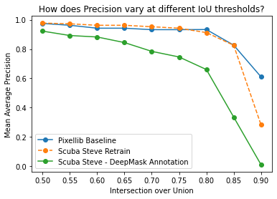
Model Performance - Detecting Butterflies
Objective: train mask_rcnn model on new object class (butterflies) using human labeled segment data and DeepMask assisted Object Proposals
Mean Average Precision - % correct class picked
Intersection over Union (IOU) - overlap of inferred mask vs ground truth
TP = images above threshold
FP = wrong class
FN = small overlap
No Butterflys
Wrong Pick
Ground Truth
Big drop off for all models at high IOU
Bad Mask
Yeah!
Scuba Steve Inference

Slide 17
Annotation Time
Average time saving per item annotated
Model Assisted Annotation on CPU | Manual Annotation
~10 sec | ~ 45 sec
5x time saving per item annotated running on CPU inferences.

Slide 18
Next Steps

Slide 19
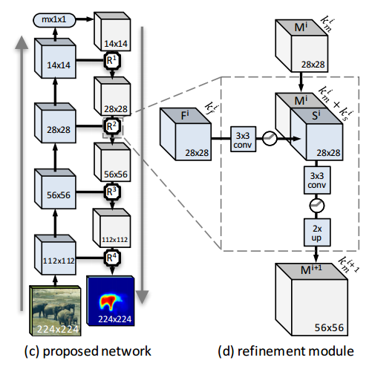
Mask Refinement
Some anecdotal improvements in automated annotation by combining region proposals from DeepMask.
Can further refine this by using SharpMask to draw even finer Region Proposals
Constrained Deep Learning - refine the architecture to look for only one object within the bounding box.
SharpMask Refinement Arch

Slide 20
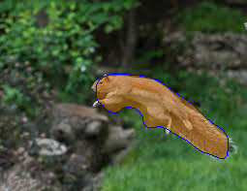
One Region Proposal - Not up to “sniff”
Looks pretty good but is clearly missing an important part of our squirrel. Its nose!

Slide 21
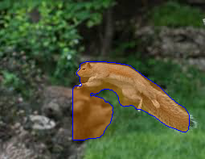
Nine Region Proposals - Too squirrelly
We’re capturing more than just our flying hero now!

Slide 22

Six Region Proposals - Nuts about it
We’ve got the snout that we wanted and not too much more. This is our Goldilocks Mask.

Slide 23
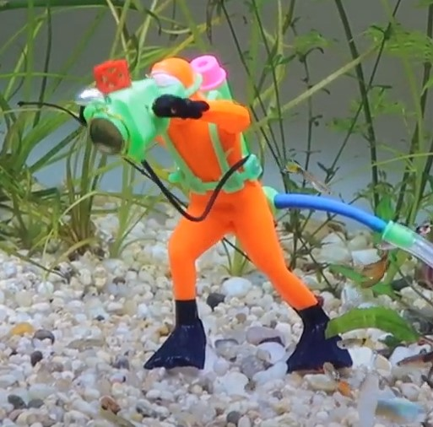
This project will live on
Move from DeepMask to SmartMask or something new
Advance ideas for region proposal selection
Streamline process for retraining based on newly annotated images
Experiment with image size and resolution for retraining speed and accuracy
Math optimization and performance improvement
User loading of pictures
Recommended label override

Slide 24
Appendix

Slide 25
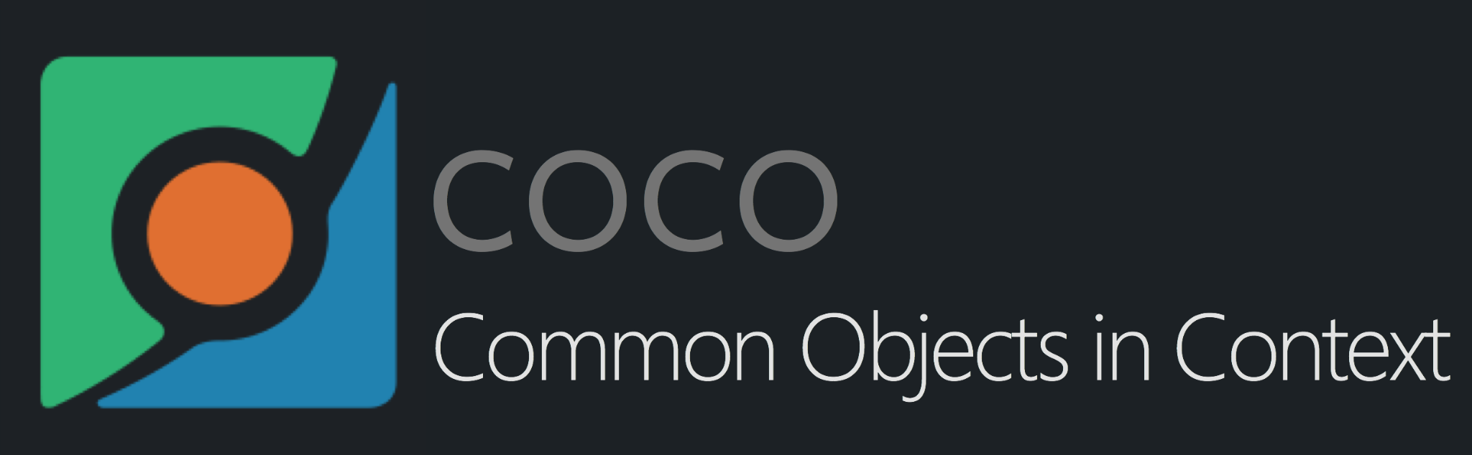
Dataset
COCO is a large-scale object detection, segmentation, and captioning dataset and the dataset used to generate the model for instance.
ADE20K: The ADE20K semantic segmentation dataset contains more than 20K scene-centric images exhaustively annotated with pixel-level objects and object parts labels. There are totally 150 semantic categories, which include stuffs like sky, road, grass, and discrete objects like person, car, bed.
Nature Dataset with Butterfly and Squirrels.
Notes:
Zhou et al. in Scene Parsing Through ADE20K Dataset, https://paperswithcode.com/dataset/ade20k

Slide 26
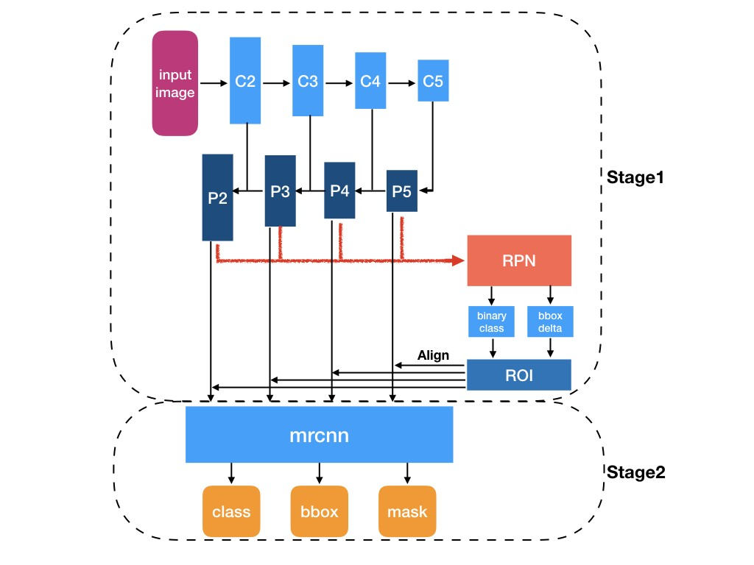
Why Mask R-CNN?
Mask R-CNN is simple to train.
Mask R-CNN outperforms all existing, single-model entries on every task.
The method is very efficient and adds only a small overhead to Faster R-CNN.
Mask R-CNN is easy to generalize to other tasks.

Slide 27
Extracting more from DeepMask
DeepMask provides multiple region proposals. Initially we were just using the region proposal with the highest confidence. But we found in certain cases combining proposals could enhance the quality of the mask.
Through a simple but logical process we developed a method to iteratively refine the mask DeepMask creates on our flying squirrel.

Slide 28
Takeaways and Key Learnings
Computer Vision can assist with a lot of annotation providing at the very least a start for an annotator to correct.
Even semi-automated labeling where the human draws a bounding box and picks a class and DeepMask provides the labeled mask produces powerful results.
This process tends to work well with images where the new target class is highly present in the image.

Slide 29
Model Tuning
Tune hyperparameters and experiment with results training with different epochs and augmentation configurations.
Constrained Deep Learning - refine the architecture to look for only one object within the bounding box.
Validation loss fluctuation suggests learning rate may be too high.
Could not have high batch size due to OOM, potentially decrease image resolution for this.

